Slide 1
EXPH
SECURING ACCESS TO HEALTH CARE IN THE EUROPEAN UNION
Lasse Lehtonen

Slide 2
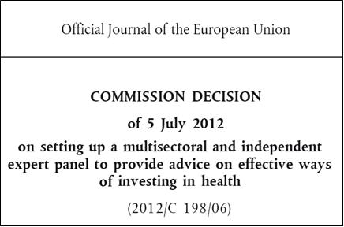
Expert Panel on Effective Ways of Investing in Health (EXPH)
The Council of the European Union invites the Commission to support the reflection process through appropriate measures, including by facilitating the access to informal and independent multisectoral expert advice to be provided on request to Member States and/or the Working Party on Public Health at Senior Level
The Expert Panel has started its
activities on 11 July 2013

Slide 3
The Mission of EXPH
To provide the Commission, upon its request, with advice on effective ways of investing in health
In providing advice, to take into account the work of other Union bodies concerned with the sustainability of health systems (e.g. Economic Policy Committee, Social Protection Committee)
Advice is non-binding
Commission will circulate advice to Member States

Slide 4
Opinions
30 October 2015:Preliminary opinion on the ‘Disruptive Innovation. Considerations for health and health care in Europe’
29 September 2015: Access to health services in the European Union - Preliminary opinion
03 August 2015:Cross-border Cooperation
12 June 2015: Competition among health care providers in the European Union - Investigating policy options
14 October 2014: Future EU Agenda on quality of health care with a special emphasis on patient safety
15 July 2014: Definition of a frame of reference in relation to primary care with a special emphasis on financing systems and referral systems
27 February 2014: Definition and Endorsement of Criteria to Identify Priority Areas When Assessing the Performance of Health Systems
27 February 2014: Health and Economic Analysis for an Evaluation of the Public-Private Partnerships in Health Care Delivery across Europe

Slide 5
Members of EXPH
Expert Panel
Prof .Pedro Pita Barros
Prof. Margaret Barry
Prof. Helmut Brand
Prof. Werner Brouwer
Dr. Sarah Thompson
Prof. Bengt Jönsson
Prof. Jan De Maeseneer
Dr. Fernando Lamata
Prof. Lasse Lehtonen
Dr. Dorjan Marušič
Prof. Martin McKee
Prof. Walter Ricciardi
External experts
Dr Michele Cecchini Prof. Sara Willems

Slide 6
Background
Survey data indicate that in 2013 around 18 million people living in the European Union experienced unmet need for health care (3.6% of the population). Between 2005 and 2009, Member States made huge progress in improving access to health care: the number of people experiencing unmet need fell from 24 million in 2005 (5%) to 15 million in 2009 (3%). This positive trend has been reversed since 2009 – a very visible sign of the damage caused by the financial and economic crisis.

Slide 7
Common values
In 2006, the Council of Health Ministers in the European Union (EU) agreed common values and principles for EU health systems:
universality,
access to good quality care,
equity and
solidarity

Slide 8
Patient preferences
Personal preferences may result in legitimate differences in demand and, ultimately, use for a given level of need. For this reason, health systems generally aim to promote equity of access to health services, as opposed to equity in the use of health services.

Slide 9
Access to health services
Access is a multi-dimensional issue.
Barriers to access can be found at the level of individuals, health service providers and the health system. Access is also affected by public policy beyond the health system – especially fiscal policy, but also social protection, education, transport and regional development policy.

Slide 10
Mandate
The Expert Panel on Effective ways of Investing in Health (EXPH) is requested to give its views on options for action to improve equity of access to health services in the EU.

Slide 11
Mandate
In particular, the Expert Panel is requested to provide its assessment on the following points:
1. Overall impact of poor access
How do limitations and variations in access to health care affect EU health systems and the broader economy?
2. Measuring and monitoring
Which groups of people are most likely to suffer from limited access to health care? Can the Expert Panel provide a taxonomy of these groups, highlighting the main mechanisms of exclusion? What can policy makers, professional and patients' associations, and other stakeholders do to identify in a timely way problems in access to health care, including those affecting the most vulnerable population groups, and to reduce inequities in access to health services? Which monitoring tools are already in place and which tools could be developed?

Slide 12
Mandate
3. Acceptable variations
How can the limits of acceptable variation in health care access within and across Member States be defined?
4. Policy measures
How can the main barriers to access be overcome? Which tools can be used to tackle unmet need for health care and unwarranted variation? What role can the financing of the system, legislative tools or best-practice sharing play? With regard to this point, the opinion of the Expert Panel should focus on general policies and actions which can be taken at health system and health service level. Additionally, the Expert Panel is requested to reflect on how the added-value of EU action on access to health care may be maximised.

Slide 13
Access to health services in the European Union – Preliminary opinion 29 September 2015
http://ec.europa.eu/health/expert_panel/opinions/index_en.htm
Public consultation until 6 November 2015
Some 400 comments
Plenary acceptance December 3, 2015?

Slide 14
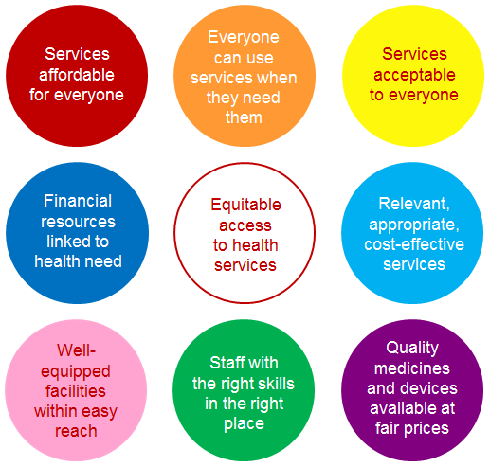
Factors affecting equitable access to health services

Slide 15
Financial resources are linked to health need
Health needs vary across and within countries. Financial resources for the health system should reflect a country’s health needs at national and sub-national levels. Failing to match financial resources to need will result in unequal access to health care and is likely to lead to inequalities in the use of health services. It is also inefficient: if some people in need of health care are not able to use services while others are using too much relative to their need, the ensuing mismatch wastes resources. Across and within EU Member States, financial resources for health care vary in ways that are unrelated to health needs.

Slide 16
Share (%) of people reporting unmet need for health care due to cost, travel distance, waiting time and lack of time, poorest and richest quintiles, EU27, 2005-2013

Slide 17
Mismatch between need and ability to pay
The mismatch between need for health care and ability to pay means that collective, public spending, incorporating a degree of redistribution, is essential to ensure equitable access to health. In 2013, public spending on health varied from a low of 3.4% of GDP in Cyprus to a high of 10.3% of GDP in the Netherlands, with a median of 6.1%. The health share of the government budget (total public spending) ranged from 7.5% in Cyprus to 20.7% in the Netherlands, with a median of 13.5%.
The mismatch between need for health care and ability to pay means that collective, public spending, incorporating a degree of redistribution, is essential to ensure equitable access to health.
In 2013, public spending on health varied from a low of 3.4% of GDP in Cyprus to a high of 10.3% of GDP in the Netherlands, with a median of 6.1%. The health share of the government budget (total public spending) ranged from 7.5% in Cyprus to 20.7% in the Netherlands, with a median of 13.5%.

Slide 18
To ensure an adequate level of spending on health:
- All countries should link the availability of public funding for health to population health needs. This is especially important during economic downturns, when funds may decline but needs are likely to increase.
- Countries with low levels of public spending on health should allocate a higher share of the government budget to the health sector.
- Countries should ensure that public funding is used effectively, rather than simply driving up the prices of technology or highly specialised staff.

Slide 19
To ensure the distribution of spending meets regional health needs
- Countries should introduce and improve sub-national resource allocation formulas, building on the long experience of developing formulas in countries such as England and Sweden. Provider payment should not be based primarily on inputs and should for population health needs and provider performance.
- The European Union can facilitate this by routinely collecting data on sub-national health care expenditure patterns; identifying regions and groups in particular need of additional public spending on health; ensuring unmet need is accounted for in country-specific recommendations made as part of the European Semester; and helping countries develop secure systems of record linkage, including unique patient identifiers.

Slide 20
Services are affordable for everyone
People should not be prevented from using necessary health services because the costs associated with use are too high. Financial barriers to access can be caused by a wide range of factors at individual, provider and health system levels, including factors beyond the health system – for example, the adequacy of pensions and unemployment benefits or the cost of transport. Affordability issues most commonly arise where public spending is low as a share of total spending on health and where there are gaps in the breadth, scope and depth of publicly financed coverage. As a result of these gaps people have to buy voluntary health insurance or pay out-of-pocket or – if they cannot afford these options – rely on health services provided by NGOs.

Slide 21
Out of pocket payments as a share (%) of total spending on health, EU28, 2013

Slide 22
To ensure affordable access countries should
- Ensure most spending on health comes from collective public rather than private sources.
- Ensure out-of-pocket payments are as low as possible.
- Identify and close gaps in publicly financed coverage of cost-effective services.
- Broaden the basis for entitlement to encompass everyone living in a country, regardless of legal status.
- Eschew discriminatory approaches such as entitlement linked to employment status and payment of contributions or situations in which people with different diagnoses are entitled to different benefits (‘inequity by disease’).
- Reduce or eliminate user charges so that they do not create financial barriers to cost-effective services or undermine financial protection.
- Ensure efficiency in spending public resources, paying attention to the scope of the benefits package, prioritising cost-effective health services, including elements of performance in provider payment and developing appropriate pricing strategies.
- Eliminate informal payments using a mix of policy instruments.
- Outside the health sector, fiscal social protection policies are critical to addressing poverty and income inequality.

Slide 23
Well-equipped facilities are within easy reach
Proximity to health facilities is determined by a number of interrelated factors, including the topography of the land, the density of the population and the quality of the transport infrastructure. The situation may be compounded by the maldistribution of facilities due to a failure of planning or official neglect
Geographical barriers present inevitable trade-offs.
The provision of modern health services requires facilities with 24-hour cover of a range of specialties. An equitable distribution of services is not simply a matter of funding. It also requires a substantial number of staff with qualifications that cannot easily be substituted, as well as a sufficient workload to justify employment and ensure staff retain their skills.

Slide 24
Share (%) of people that have to travel for more than 20 minutes to reach their nearest primary care facility, EU27, 2013

Slide 25
Potential solutions lie in two broad areas:
- To engage in area-level planning with the aim of creating networks of dispersed facilities feeding into a central one, based on agreed clinical pathways.
- To develop mechanisms to facilitate the transport of patients to health facilities or health professionals to patients.

Slide 26
There are enough health workers, with the right skills, in the right place
Health systems across Europe are facing shortages of health workers for a number of reasons.
First, few countries are training adequate numbers of health professionals.
Second, health workers are increasingly mobile in a globalised economy and in the context of the single market in Europe; those who feel they are not being adequately rewarded for what they are doing can easily move somewhere else.
Third, there may be problems within countries, where it can be difficult to recruit and retain health workers in isolated rural areas with few employment opportunities for partners, limited leisure infrastructure or weak provision of education for children

Slide 27
To address these issues countries should
- Put in place processes to train adequate numbers of health workers. Unfortunately, workforce planning has had a very poor record in most countries.
- Establish working conditions designed to retain staff in underserved countries and areas: not only remuneration commensurate with skills, but also attention to broader working conditions, including access to peer support and continuing professional development.
Ensure an appropriate mix of skills is in place.
This may require investment in additional administrative or care staff to relieve pressure on specialised health professionals (and, in a period of austerity, avoiding short-sighted cuts in staff); the development of new roles, with more advanced skills, such as specialist nurses; and task shifting, with delegation of certain roles to less specialised staff. Skill mix developments often require significant changes to the organisational structure of the health facility, recognising that new responsibilities require different reward systems and can challenge existing professional hierarchies. They must also take account of the widespread existence of financial incentives that serve to maintain the status quo.

Slide 28
Quality medicines and medical devices are readily available
Medicines and medical devices contribute significantly to health and quality of life. They account for around 25% of total spending on health care and employ over a million people across the European Union. The efficient use of these vital resources is critical to guaranteeing equitable access to safe and high quality health services
The high price of many medicines is becoming an increasing problem for health systems in EU countries, threatening fiscal sustainability.

Slide 29
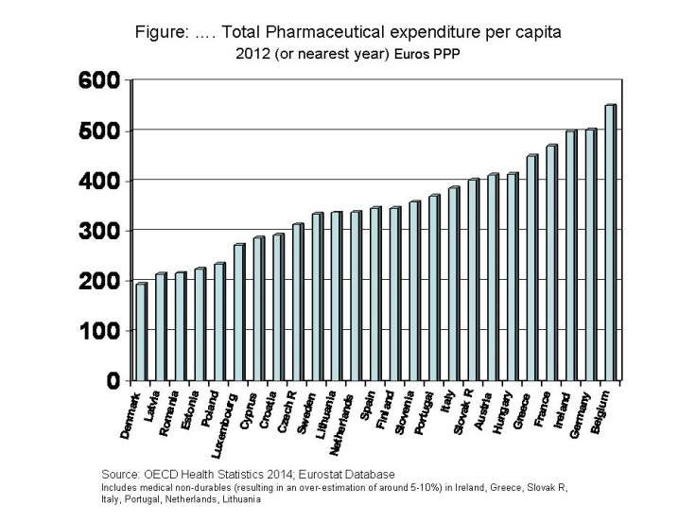

Slide 30
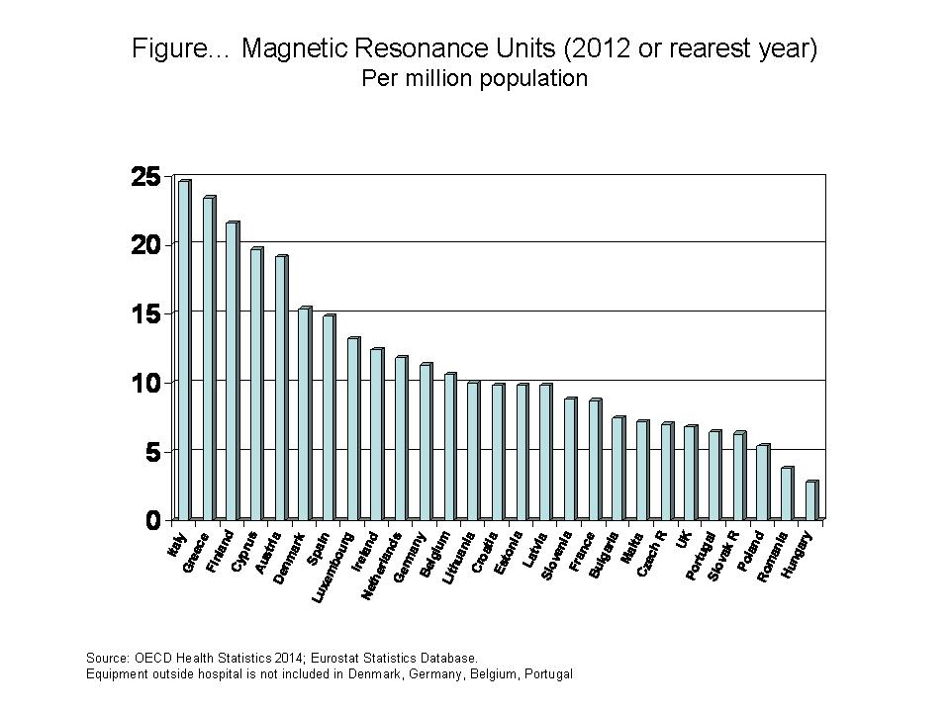

Slide 31
To address these problems, countries should:
- Ensure fairer prices by identifying more efficient ways to fund R&D, requiring much greater transparency around costs and prices and developing joint procurement agreements for medicines and medical devices.
- Define national policies on medical devices (in addition to medicines).
- Systematically use HTA, including cost-effectiveness and cost-utility analysis, to inform coverage decisions and disinvestment for medicines and medical devices.
- Encourage rational prescribing and use of medicines and medical devices through ‘wise lists’, algorithms, guidelines, capacity planning of big-ticket equipment and specialised medical equipment management units.
- Improve information systems and data collection at regional, national and EU level.

Slide 32
People can use services when they need them
People may find it difficult to use health services when they need them due to: lack of information about services, especially if information is not provided in the patient’s language; low levels of literacy in general and health literacy in particular; factors affecting the convenience of services for the general population, such as the absence of an effective appointments system (recognising that not all have access to the internet) or the limited availability of out-of-hours services, home visits, repeat prescriptions by telephone and email or mobile phone contact with providers; the extent to which services are equipped to meet the needs of people with disabilities; and long waiting times.

Slide 33
Health literacy
Comparative data on health literacy –suggest inadequate health literacy is a widespread problem affecting the general population. They also indicate a clear socio-economic gradient, with lower levels of health literacy concentrated among people with poor health status, high health care use, low socio-economic status, lower education and older age (over 75 years). The evidence base for strategies to improve health literacy is weak and needs to be strengthened.

Slide 34
Waiting times
Many national waiting time initiatives have been criticised for failing to prioritise access to treatment based on severity of illness and, in some instances, for creating perverse incentives to prioritise patients with relatively minor needs. Nevertheless, attempting to specify and adhere to maximum waiting times and efforts to provide the public with reliable information on waiting times can play a role in enhancing transparency, accountability and other dimensions of health system performance.

Slide 35
Services are acceptable to everyone
People need to be willing to use services, especially in primary care, which is the first point of contact with the health system for many people. Services that fail to be acceptable to people are likely to be under used, with negative implications for health, efficiency in the use of health system resources and equity in use.
User experiences may be sub-optimal due to not having enough time with the provider, communication failures, lack of involvement in care decisions, lack of respect and lack of privacy.

Slide 36
Policy responses lie in the following areas:
- Strengthen the development of culturally sensitive and appropriate services (cultural competence).
- Improve the communication skills of health workers.
- Develop e-health systems for better informational and service continuity.
- Conduct regular national surveys of user experience of the health system

Slide 37
Services are relevant and cost-effective
Promoting access does not mean making everything available to everyone at all times. In the context of limited resources, it is important to ensure that spending on health is as cost-effective as possible.
While the publicly financed benefits package needs to be broad, covering the full spectrum of services from health promotion, disease prevention and early detection to disease management, treatment, rehabilitation and palliative care, it should also be relevant to the health needs of the population and defined and delivered in a way that is consistent with need and evidence, including evidence of cost-effectiveness. Otherwise, the right services may not be provided to the right people at the right time at least cost, with negative implications for quality, efficiency, equity and financial protection

Slide 38
Countries should adopt a comprehensive strategy mainly targeting health workers, but also patients and the public
- Ensure the publicly financed benefits package covers the full spectrum of services, is correlated with population health needs and does not result in inequity by disease.
- Take steps to avoid over-medicalisation.
- Put in place systematic priority-setting processes to enable HTA-informed, cost-effective coverage decisions for both new and existing technologies.
- Develop clinical pathways, guidelines and systems of referral, adapt single-condition guidelines to meet the needs of people with multiple morbidities and monitor adherence to guidelines.
- Train and support health workers to deliver services in line with evidence.
- Ensure all patients have access to adequate and accessible information about treatment options and outcomes.
- Establish information systems to identify (and publicly report on) practice variations and patient outcomes and to support effective decision making by health professionals and patients. This should include decision aids for patients to help them assess the potential benefits and risks of different treatment options.

Slide 39
Delisting
HTA focuses on new technologies rather than on disinvestment:
To date, only a handful of EU countries systematically uses HTA for disinvestment (de-listing of existing benefits)

Slide 40
Conclusions
Access is a critical component of universal health coverage. The 28 Member States of the European Union have a clear mandate to ensure equitable access to health services for everyone living in their countries.
This does not mean making everything available to everyone at all times. Rather, it means addressing unmet need for health care by ensuring that the resources required to deliver relevant, appropriate and cost-effective health services are as closely matched to need as possible.

